Slide 1
Informatica PowerCenter
Lesson 23: Standards And Tips

Slide 2
Lesson Objectives
In this Lesson you will learn about:
  Naming Convention
  Tuning Tips

Slide 3
Naming Conventions
Good Practice to Follow Naming Conventions
Can be project specific:-
  Workflow : wfl_ followed by workflow functionality
  Session : s_ followed by mapping name
  Mapping : m_ followed by mapping functionality
  Source : Table/File name
  Target : Table/File name
  Ports:
  Input & Output :- Column Names
  Variable:- v_ followed by functionality

Slide 4
Naming Conventions - Transformations:
Source Qualifier: sql_(followed by Source Name)
Stored Procedure: sp_(followed by purpose of transformation)
Sequence Generator: seq_
Expression: exp_
Joiner: jnr_
Lookup: lkp_
Filter: fil_
Rank: rnk_
Router: rtr_
Update Strategy: upd_
Aggregator: agg_
Normalizer: nrm_

Slide 5
Golden Rule No. 1 – Set Out Standards
In other words…….. Create a great team!
  Naming standards
    Everyone knows what it does
    Easy to pick up someone else’s work
    Don’t end up with 100 connection objects to the same database
    Don’t end up with 100 lookups to the same table
  Development Standards
    Annotate Objects clearly
    Audit trail
  Shared Object Policy
    Object Stewardship
    Single version of the truth
    Use your shared folder!

Slide 6
Golden Rule No. 2 – Know Your Data!
In other words……..talk to the data owners AND see for yourself!
  Analyse, analyse and analyse again
    Don’t always accept the statement “there are no errors in this data”
  Verify actual values against permitted values
    Devise an error handling strategy
    Implement in all mappings
    Don’t rely on the .bad files
  Verify the business rules (and get sign off!)
  Design and unit test with real data – or at least as realistic as possible
  Will design of source and target help or hinder performance?
    Indexes
    Constraints

Slide 7
Golden Rule No. 3 – Plan Your Flows
In other words…….. Know where you’re going!
  Plan for reuse
    Common lookups
    Common expressions (e.g. date conversions)
    Maple's
  Use appropriate Transformations
    Routers vs multiple filters
    SQ Override vs Joiner/Union
    Expression vs aggregator
  Make the most of the resources
    Push processing back to the database
    Why not stage files?
  Design for rerun

Slide 8
Golden Rule No. 4 – Reduce Data ASAP
In other words…….. Trash what you don’t need!
  Only connect ports that you need
    Reduces data passing through transformations
  Remove bad data early
    Route to your error handling
    Avoids excessive processing on bad data
    Complex Transforms only on verified data
  Filter / Aggregate ASAP
    If possible filter data in source qualifier
    Consider aggregation in SQL override
  Minimise Transformations
    Avoid using one expression for one calculation
    You’ll need more DTM if you have excessive transformations

Slide 9
Golden Rule No. 5 – Avoid Big Caches
In other words…….. Don’t be a waste of space!
  Pre Sort Joiners & Aggregators
    Use the order by in the source qualifier
  Only Use necessary ports
    Avoid caching large text ports if the data isn’t needed later
  Filter ASAP
    Don’t aggregate / join data you’ll trash later
  Utilise the Master / Detail properties
    Make the master the set with the fewest records
  Avoid the sorter - order by instead
  Need to sort a text file?
    Consider staging it instead!
  Size your caches for production

Slide 10
Golden Rule No. 6 – Remember It’s Shared
In other words…….. Be a good neighbour!
  Use Fewer concurrent sessions
    Running more may cause other teams to go into wait state (and in production this means missed deadlines)
  Use performance stats only when tuning
    Session requires twice the memory which may cause other sessions to fail

Slide 11
Don'ts - avoid where possible:
SQL Override
  Use source qualifier properties where possible
Multiple filters
  Try a router instead!
Sorters – Very inefficient
Field level stored procedures
  Get called for every row
Extracting more data than you need
  Filter in the source qualifier
  Only map required ports
Aggregator
  Try a SQL override
Use sorted data where possible
Create running sums in an expression instead
Use complex rules in filters and routers
Hardcode Values
Give connections environment specific names

Slide 12
The Good And the Bad
Informatica Design Examples

Slide 13
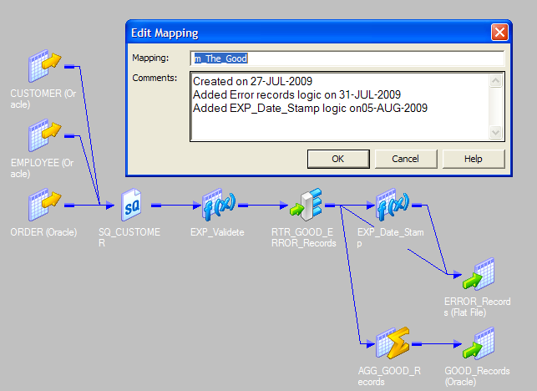
The Good………

Slide 14
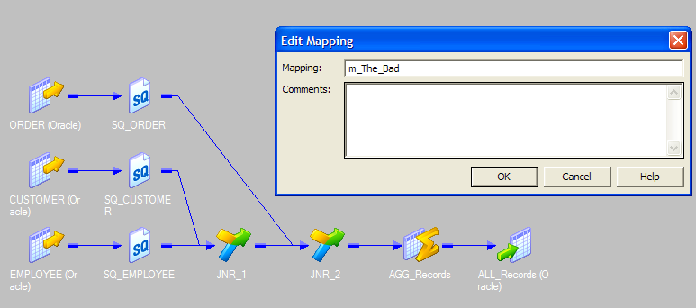
The Bad………..

Slide 15
Summary
This Lesson gives knowledge about Standard Naming convention and designing tips.

